Slide 1
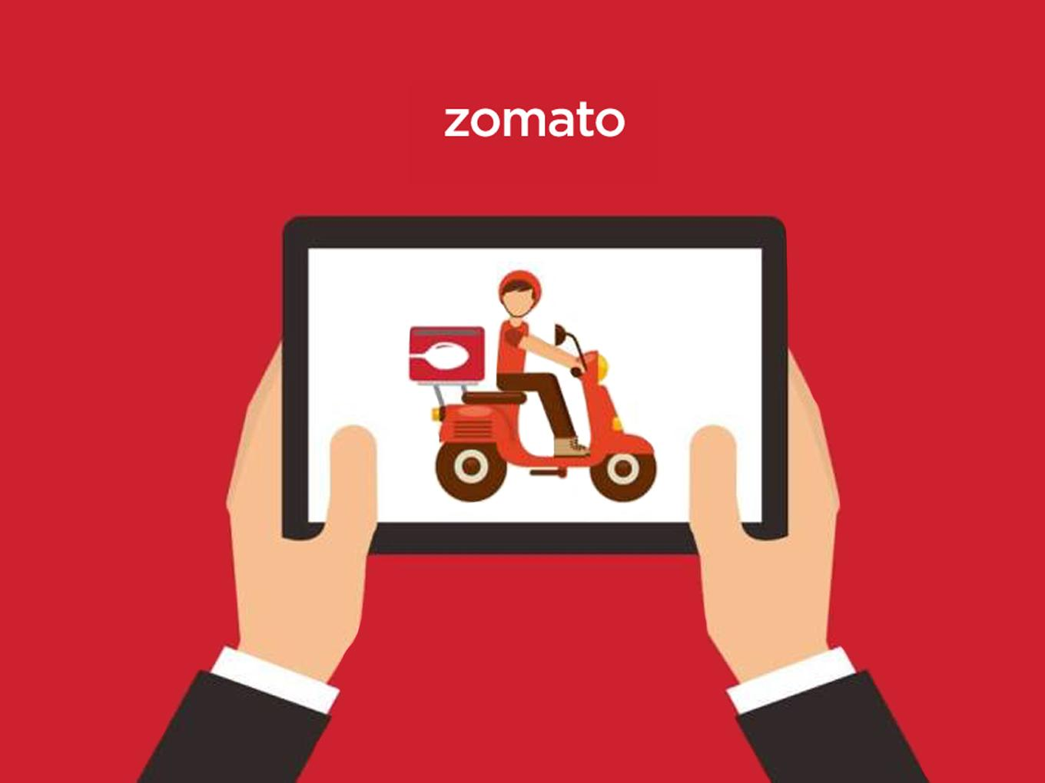
Spreadsheet Project:
Zomato Restaurants Analysis Alphin A J

Slide 2

Agenda
Problem Statement
Data Description
Objective Key Metrics and Visualizations
Subjective Question for Insights

Slide 3
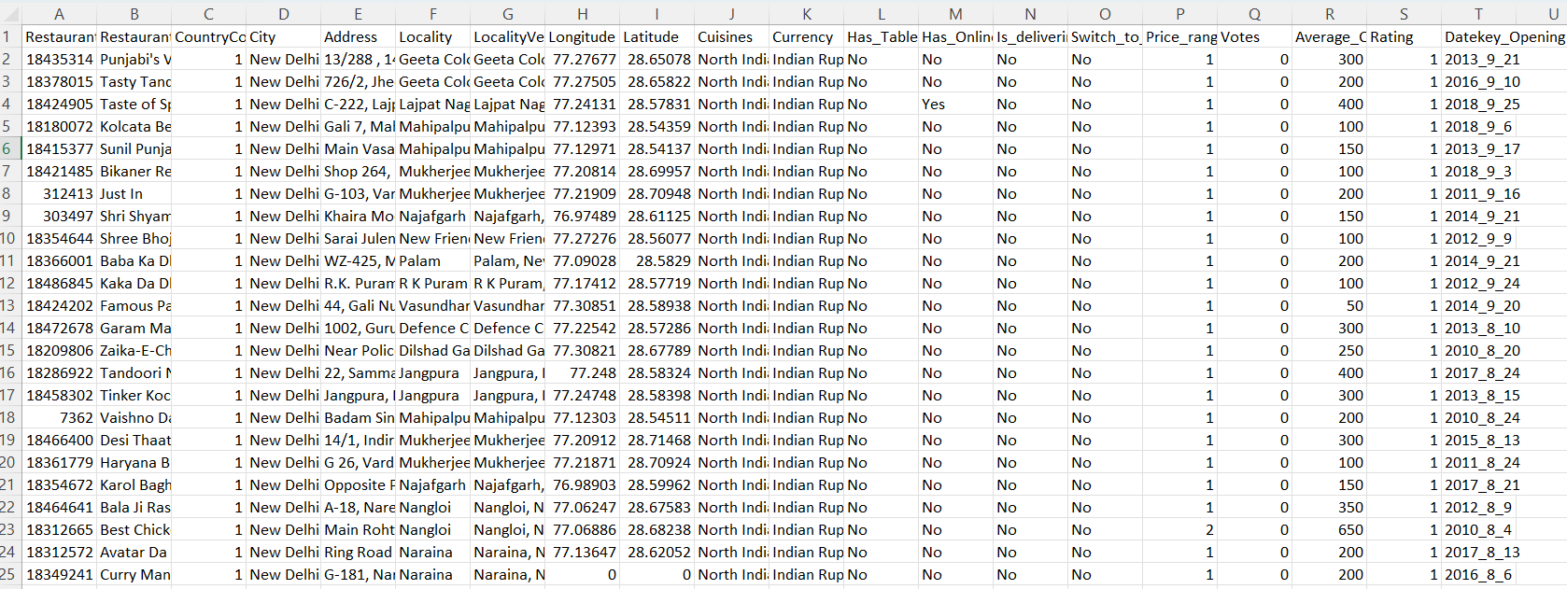
Problem Statement
You are hired as a consultant data analyst by zomato where the team is looking for expansion and opening restaurants. Your task is to come up with strategies/suggestions about opening newer restaurants.

Slide 4
The image above displays details about Zomato Sales Performance, including:
Restaurant ID: Unique identifier for each restaurant.
Restaurant Name: The name of the restaurant.
CountryCode: Country code of the location where the restaurant is situated.
City: The city where the restaurant is located.
Address: The specific address of the restaurant.
Locality: The locality or neighborhood where the restaurant is situated.
Locality Verbose: Detailed information about the locality.
Longitude: The geographical longitude coordinate of the restaurant.
Latitude: The geographical latitude coordinate of the restaurant.
Cuisines: The type of cuisine offered by the restaurant.
Currency: The currency used for transactions in the restaurant.
Has_Table_booking: Indicates whether the restaurant has a table booking option (Yes/No).
Has_Online_delivery: Indicates whether the restaurant offers online delivery (Yes/No).
Is_delivering_now: Indicates whether the restaurant is currently delivering (Yes/No).
Switch_to_order_menu: Indicates whether users can switch to the order menu (Yes/No).
Price_range: A numeric value indicating the price range category of the restaurant.
Votes: The number of votes or ratings/(feedback) received by the restaurant.
Average_Cost_for_two: The average cost for two people dining at the restaurant.
Rating: The overall rating of the restaurant is based on user reviews.
Datekey_opening: The date when the restaurant was opened.

Slide 5
Data Description
The source data (raw_data) consist of the information about each restaurants in different countries mainly; ‘Address’, ‘Rating’, ‘Cuisines’, ‘customer rating’, ‘Has online booking’, ‘Average cost for two’, ‘price range’ etc..
Based on the available data some useful insights has been derived for setting up new restaurants in respective countries.
Data info –
Shape = 9552 rows * 20 columns
Categorical columns = 12
Missing values = 9 cells.

Slide 6
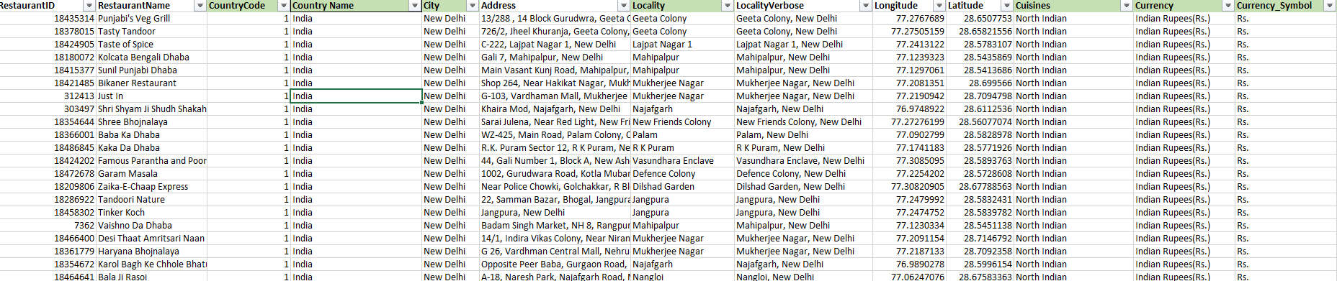
Data Preprocessing
Handling missing values – replacing with most repeated values in the respective column based on dataset, in Cuisines column blanks replaced with Mexican which is the mode in United States of America
Checking the data types of columns
Mapping Country names to Country codes using LOOKUP function.

Slide 7
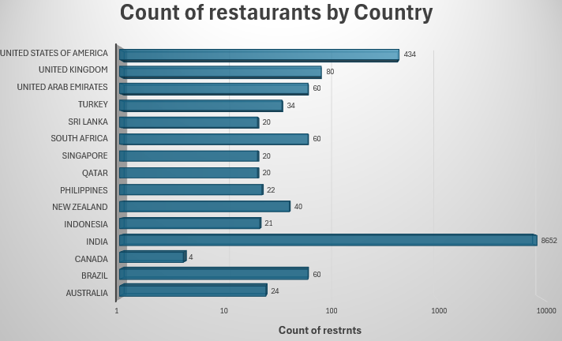
Restaurants
As from the above bar chart, India occupies highest no of restaurants followed by USA, UK and Brazil.
It indicates these regions pose a high competition for opening new restaurants for Zomato.

Slide 8
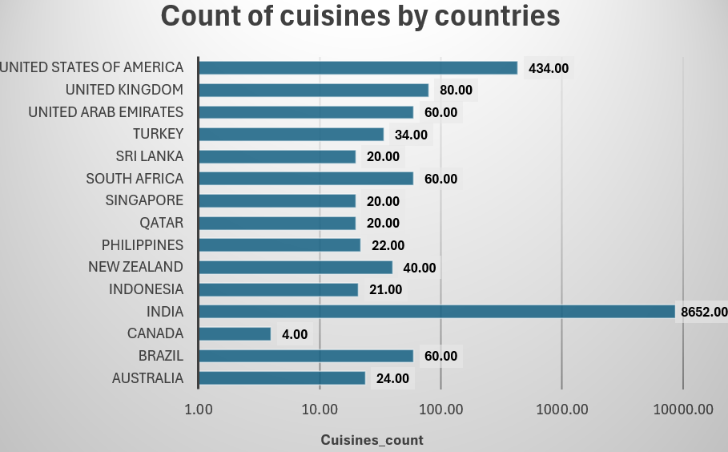
Wide Variety of Cuisines
Based on wide variety of cuisines, India stands top in having restaurants providing 8652 different cuisines.
Canada and Qatar occupies restaurants providing less food varieties which opens path for introducing new food cuisines.

Slide 9
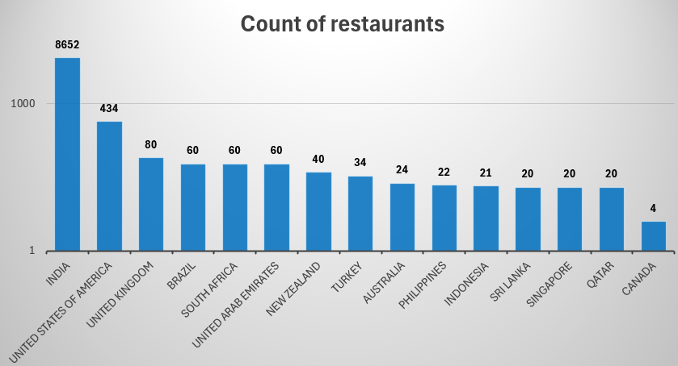
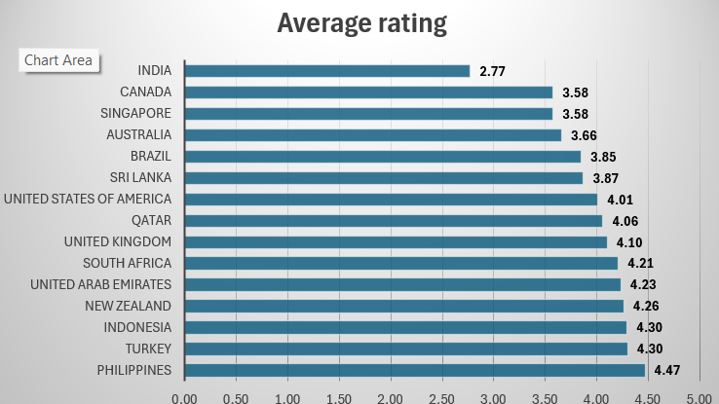
Setting up new restaurants
Factors considered for setting up new restaurants in different countries ;
Count of restaurant in each country.
Average rating of restaurants in each country.
Count of unique cuisines in each country.

Slide 10
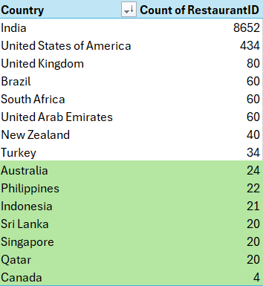
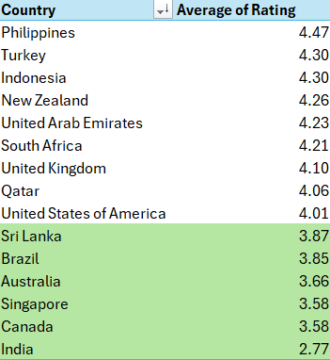
Based on the factors mentioned ; Sri Lanka , Canada, Australia, and Singapore were suggested for opening up new restaurants for Zomato.

Slide 11
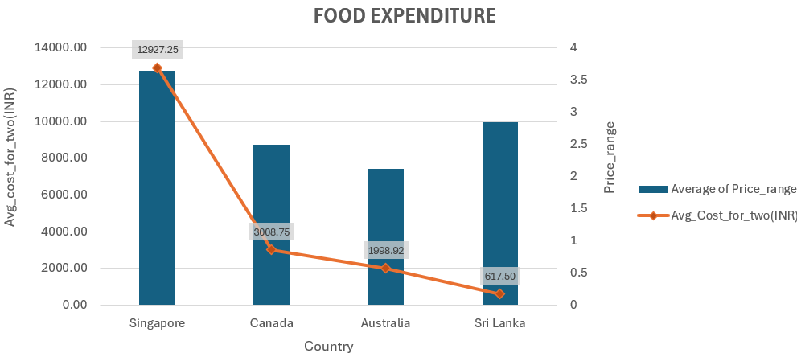
From the below visual it can be derived that Singapore has highest average cost for 2 people, price range is in 3. In countries with higher average costs for two, consumers might have a higher standard of living indicating a market that could sustain more expensive restaurant options.

Slide 12
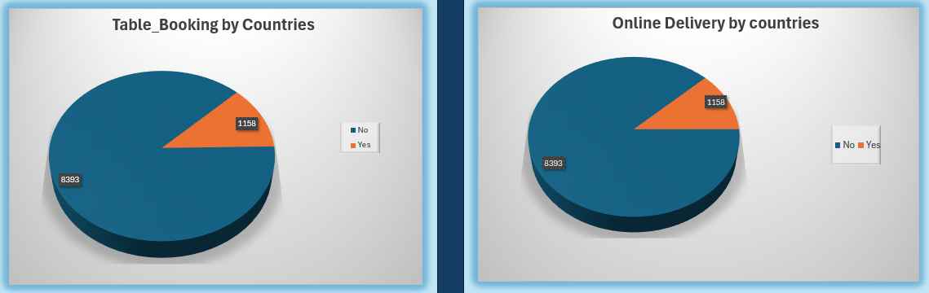
Online Delivery & Table Booking ; has an impact on the average rating for the existing restaurants in suggested cities.
This factors can be considered to get higher ratings while setting up new restaurants.
offer unique opportunities for restaurants to reach more customers, improve customer experience, and boost revenues.

Slide 13
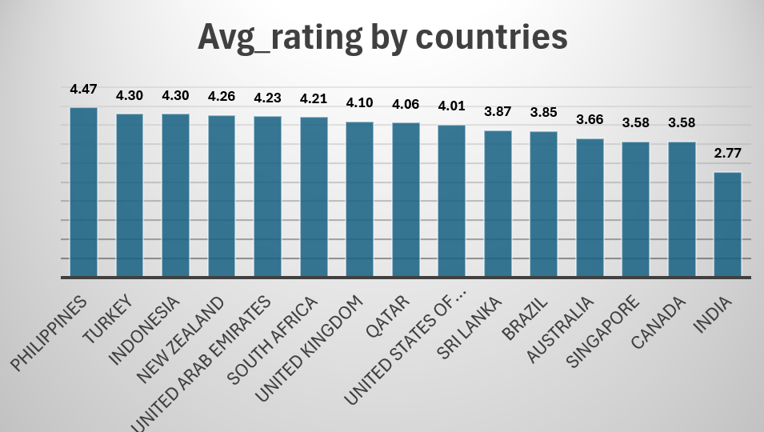
Setting up new restaurants (Cities)
Based on the average rating and count of restaurants across countries, countries like India , Canada Singapore opens a good opportunity opportunity to elevate standards and fill a quality gap by setting up new restaurants by Zomato.
In countries with higher average restaurant ratings, customer expectations around service, ambiance, and dining experience may be higher.

Slide 14
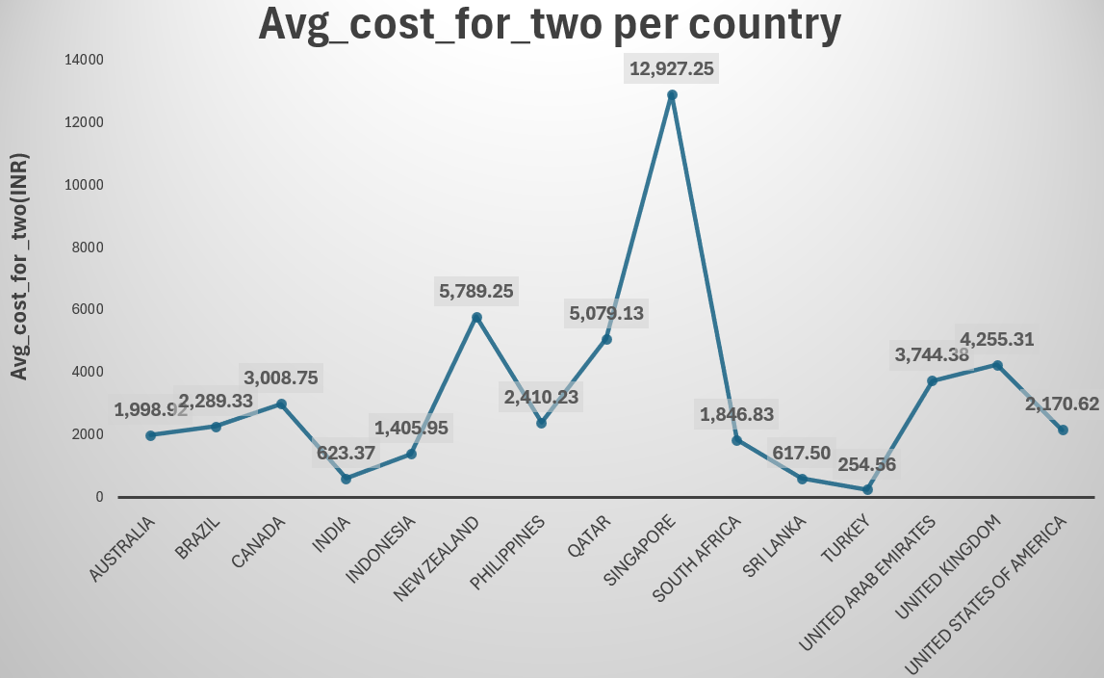
Expenditure across countries
Based on the average cost_for_two people for dining across different countries, Singapore posess the highest of all countries which shows the income prerference , standard of living of people living there. This factor can be considered for setting up the price categories for new restaurants in the suggested countries.

Slide 15
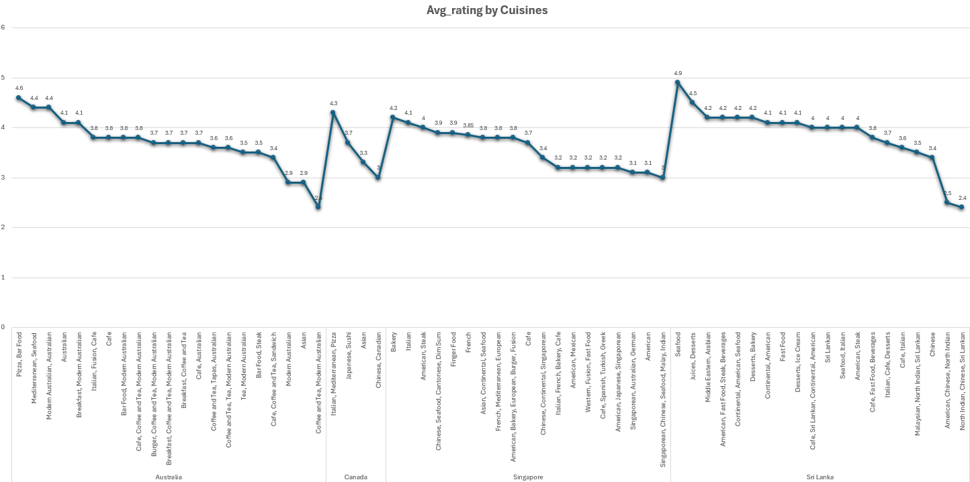
Varieties of cuisines
People in different countries have different types of cuisines. Based on the cuisine preferences, new restaurants can come up with food items which has most higher ratings.

Slide 16
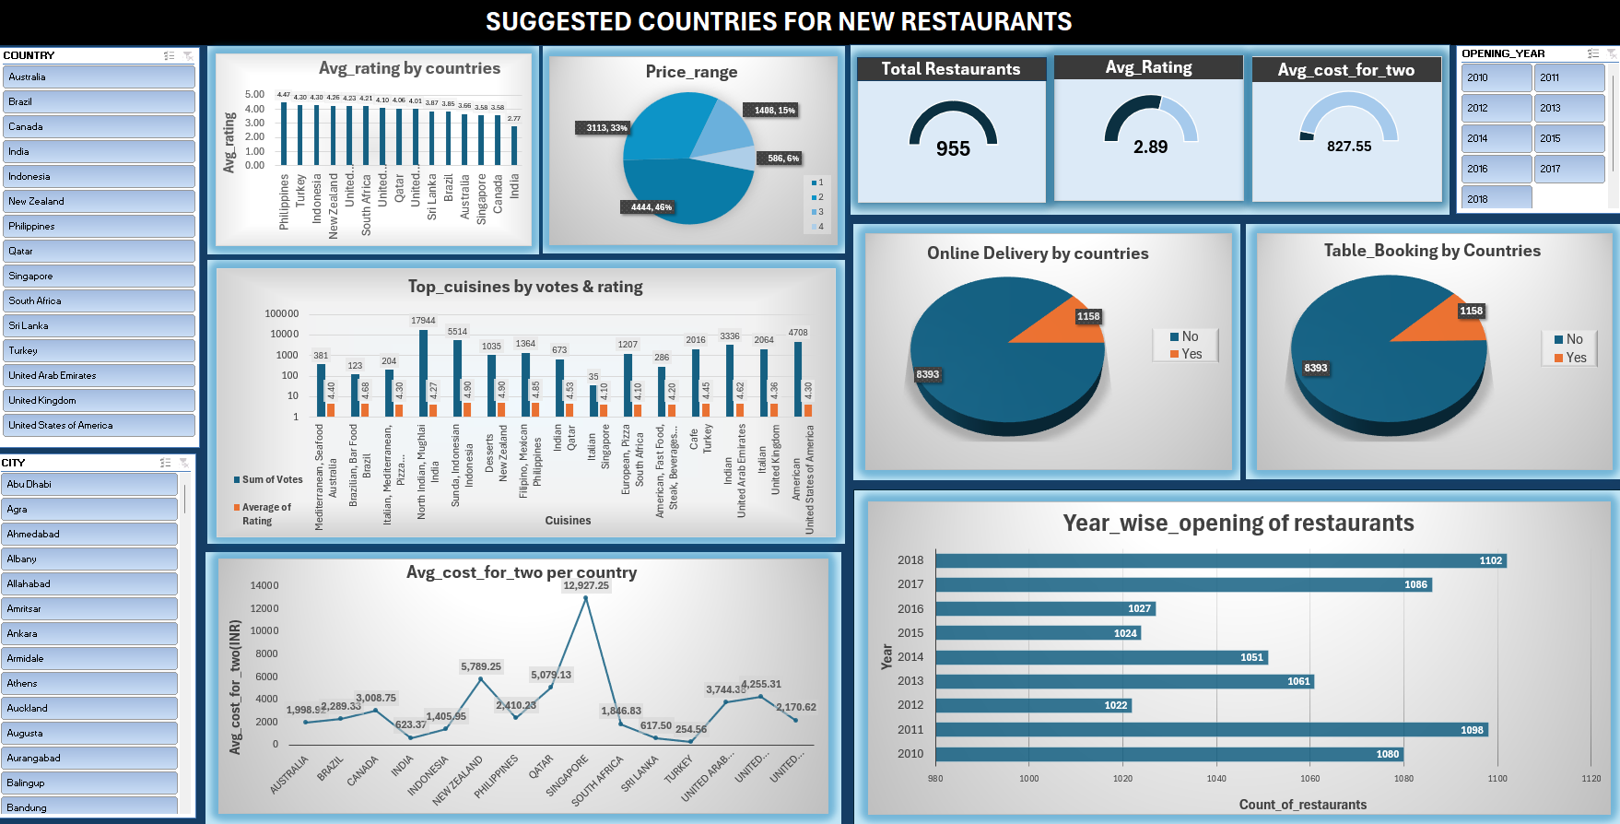
Dashboard
The following dashboard provides comprehensive insights for setting up new restaurants in the suggested countries. It includes slicers that allow filtering visuals based on criteria such as opening year, city, availability of online delivery, table booking, and more.

Slide 17
Recommendations
The scope of opening new restaurants in the countries can be considered on various factors ;
Location Analysis :
Based on count of restaurants in each country the countries can be selected for opening new restaurants. Also the avg ratings for each restaurants
Countries like Australia, Canada, Singapore, Sri Lanka have less no of restaurants which offers less competition in the market.
Varieties of cuisines :
Cuisines play a critical role in the decision-making process for setting up new restaurants, as they influence customer demand, operational logistics, marketing, and even location strategy.
In the suggested countries, new restaurants can provide cuisines which are of high demand in the
particular area along with twist of providing wide varieties to be more competitive.
Customer Feedback and Ratings (Votes, Rating) :
Areas with low ratings and few restaurants might indicate a gap in quality. These areas offer opportunities for higher-quality food options.
Target Audience :
Identifying cities or localities with younger populations that may prefer fast, trendy food and prioritize online delivery.

Slide 18
Conclusion
Based on;
Count of restaurants.
Average rating of restaurants.
Count of unique cuisines.
Countries like Australia, Canada, Sri Lanka & Singapore can be selected for setting up new restaurants for Zomato which provides a good market for a restaurant to grow up.
Based on;
Count of restaurants.
Average rating of restaurants.
Food expenditure
Table booking & online delivery service.
Cities like Consort, Yorkton, Chatham-kent & Vineland station can be considered for opening new restaurants in the suggested countries.

Slide 19


